Slide 1
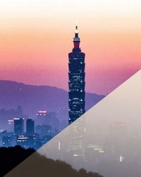

MALNAD COLLEGE OF ENGINEERING,HASSAN An autonomous institution under VTU, Belagavi
INFORMATION SCIENCE AND ENGINEERING
MAIN PROJECT
Dehazing Foggy Images Using Dark Channel Prior Method
PRESENTED BY :
A NADA FAZAL - 4MC20IS001
DEEPIKA B.V - 4MC20IS012
NAMITHA D - 4MC20IS029
THEJASWINI B S -4MC20IS057
Notes:
To change the image on this slide, select the picture and delete it. Then click the Pictures icon in the placeholder to insert your own image.

Slide 2
CONTENTS
Introduction
Existing system
Literature survey
Problem statement
Proposed system
Requirements
System design
Implementation
Tools used
Snapshots
Conclusion

Slide 3
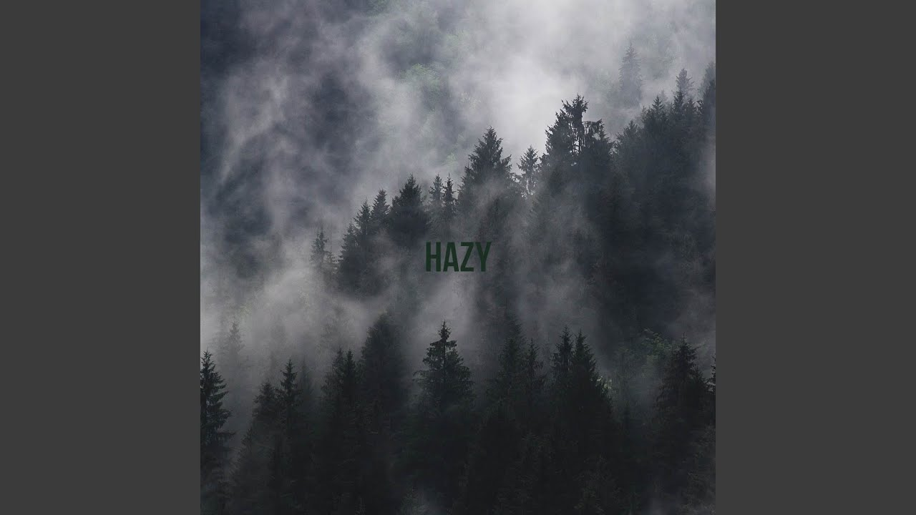
INTRODUCTION
The quality of image may degrade due to bad weather condition and presence of suspened particles like fog , dust, mist and haze etc. in the atmosphere.
Therefore, the dehazing of the image needed to overcome the impact of this unwanted weather factors.
Dehazing is the procedure to extract the haze effect from the degraded image and reconstruct the original colours of the degraded image.

Slide 4
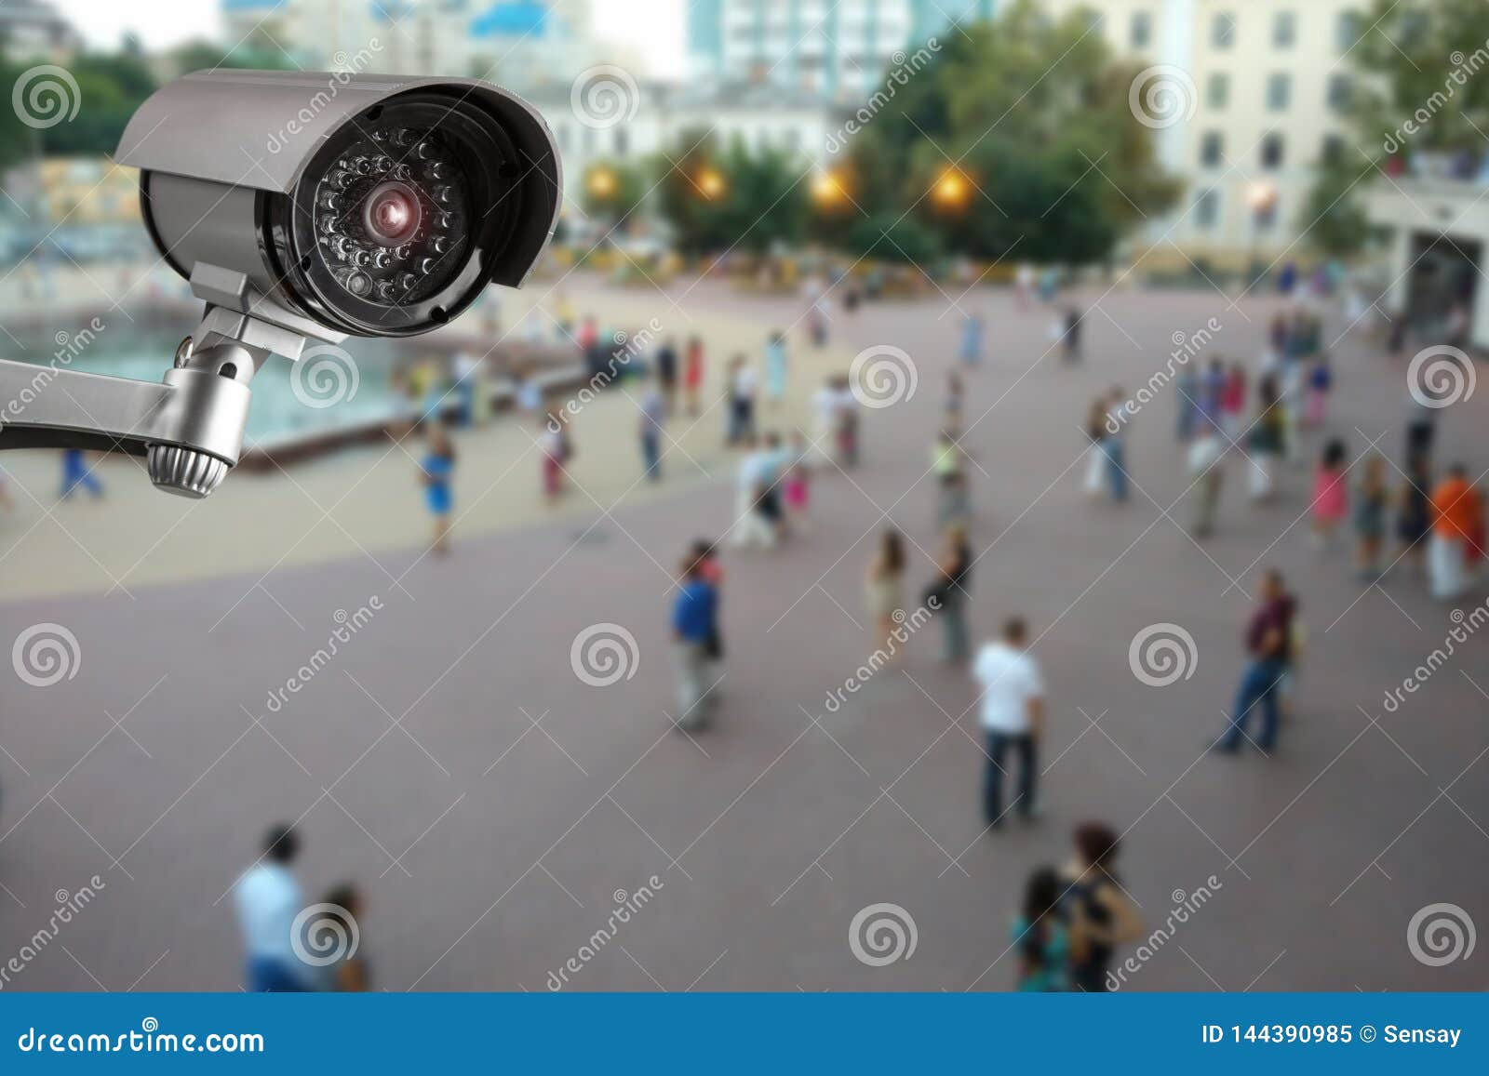
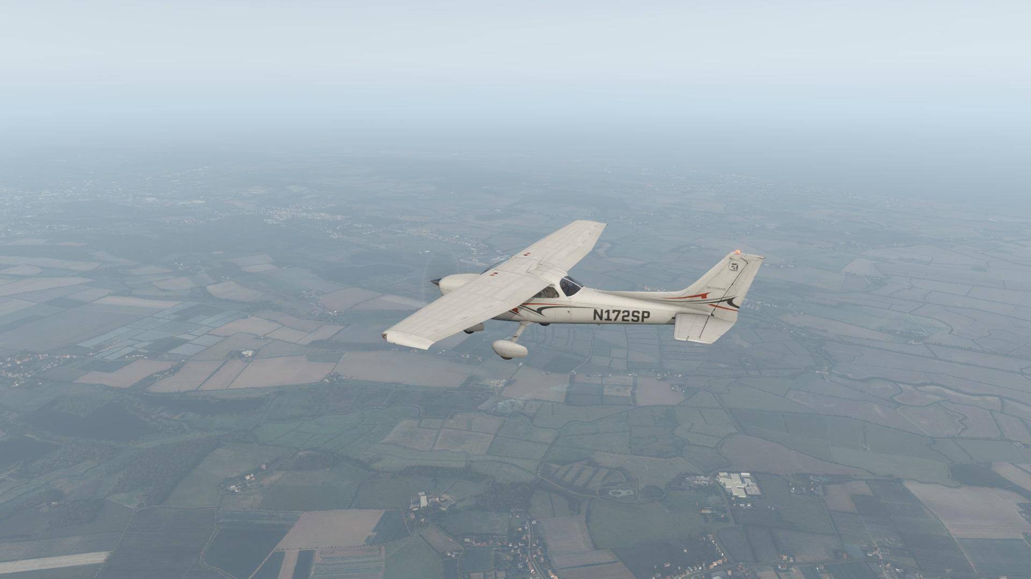
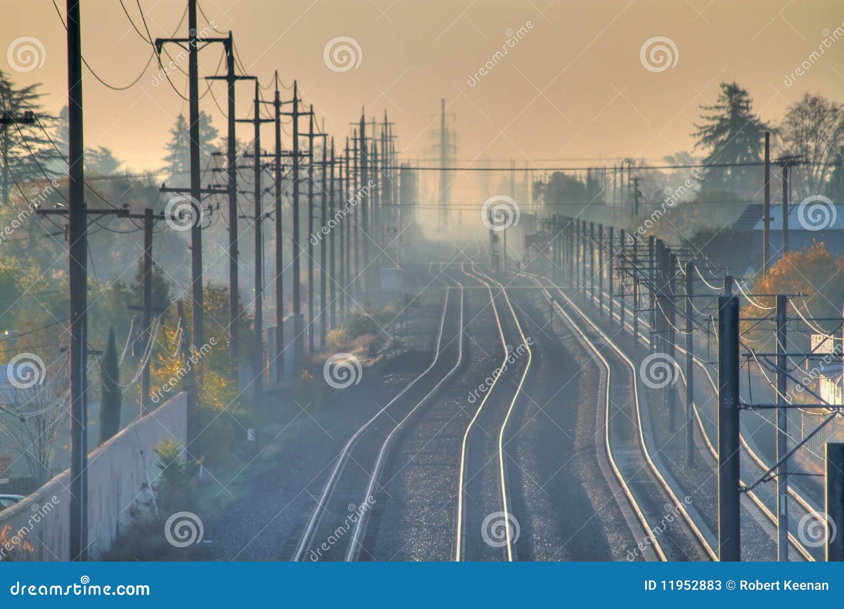
SYSTEM ANALYSIS
Existing System
The Hazy image will degrade the quality and suppress the details in the applications like :
Surveillance
Airlines
Travelling etc.
May not be possible for any observations in the hazy image .
So the haze should be removed and the quality of the image need to improved.

Slide 5
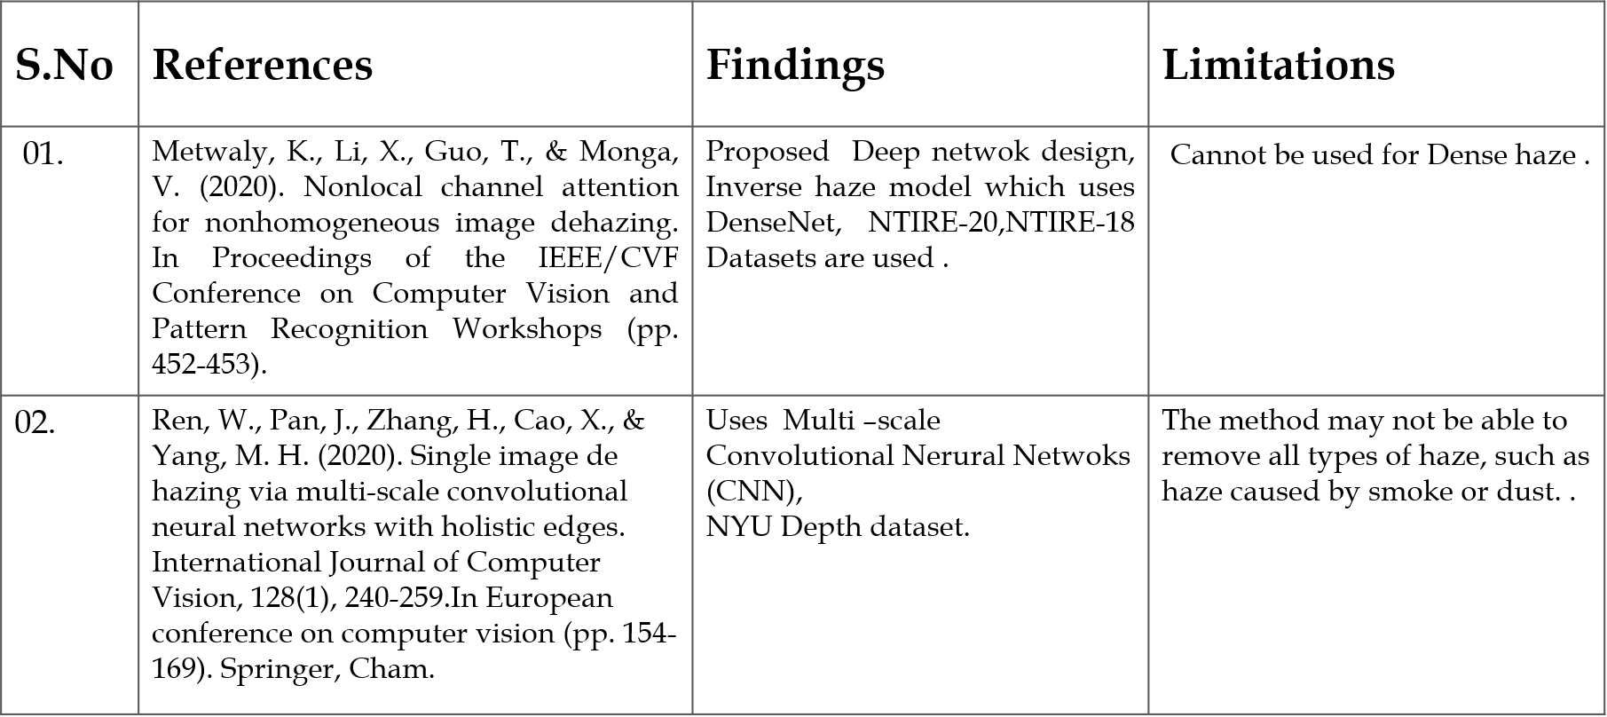
LITERATURE REVIEW

Slide 6
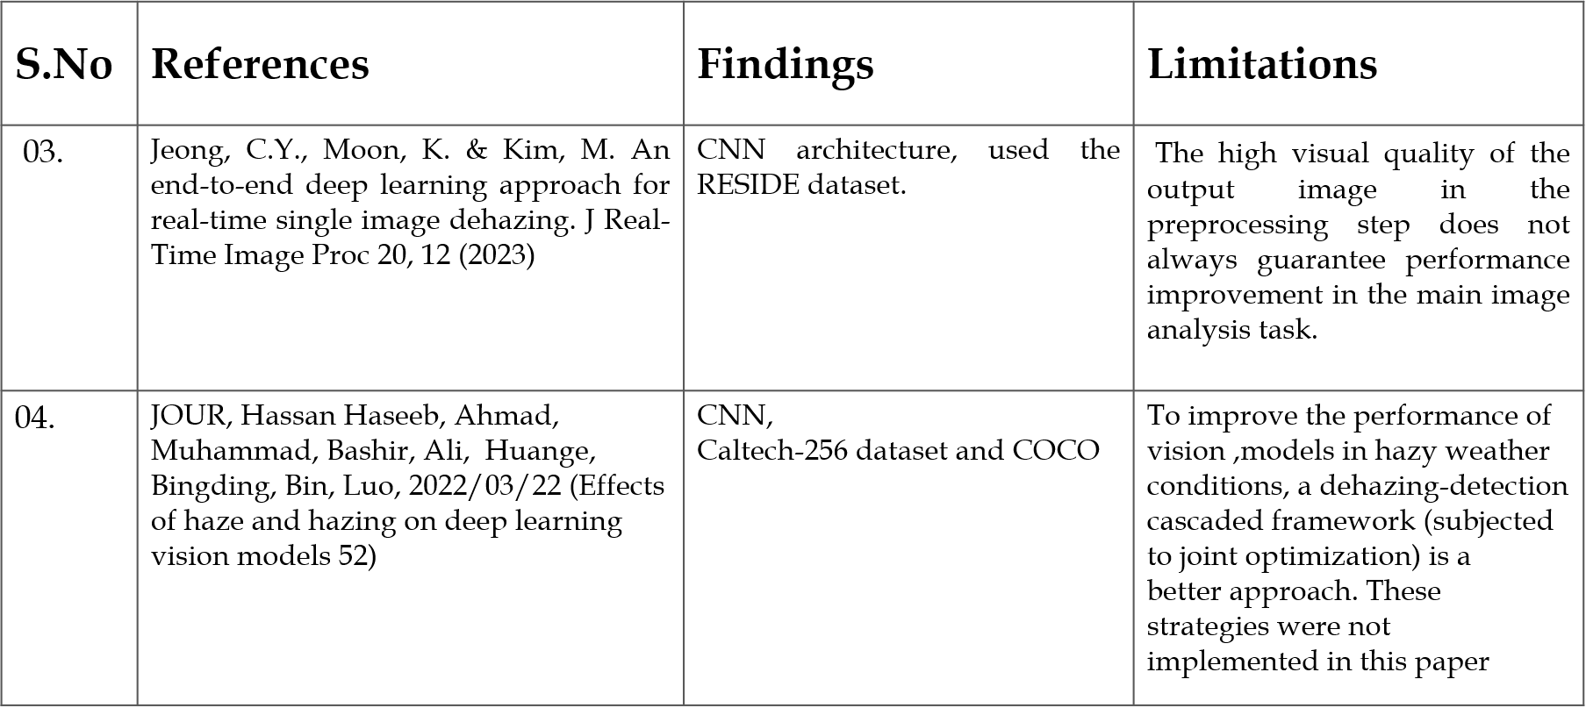
LITERATURE REVIEW (Continued)

Slide 7
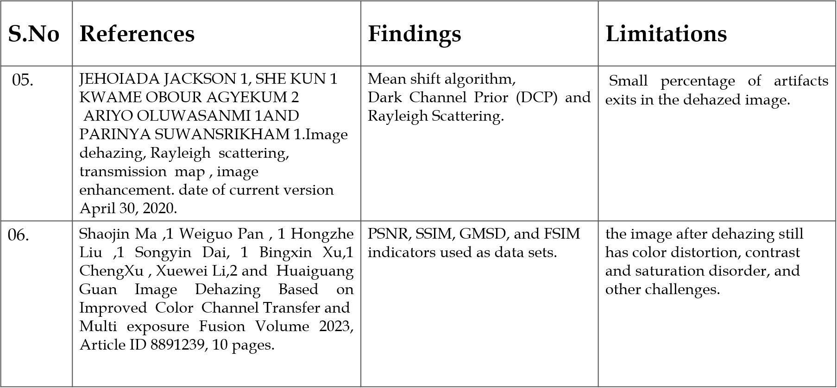
LITERATURE REVIEW (Continued)

Slide 8
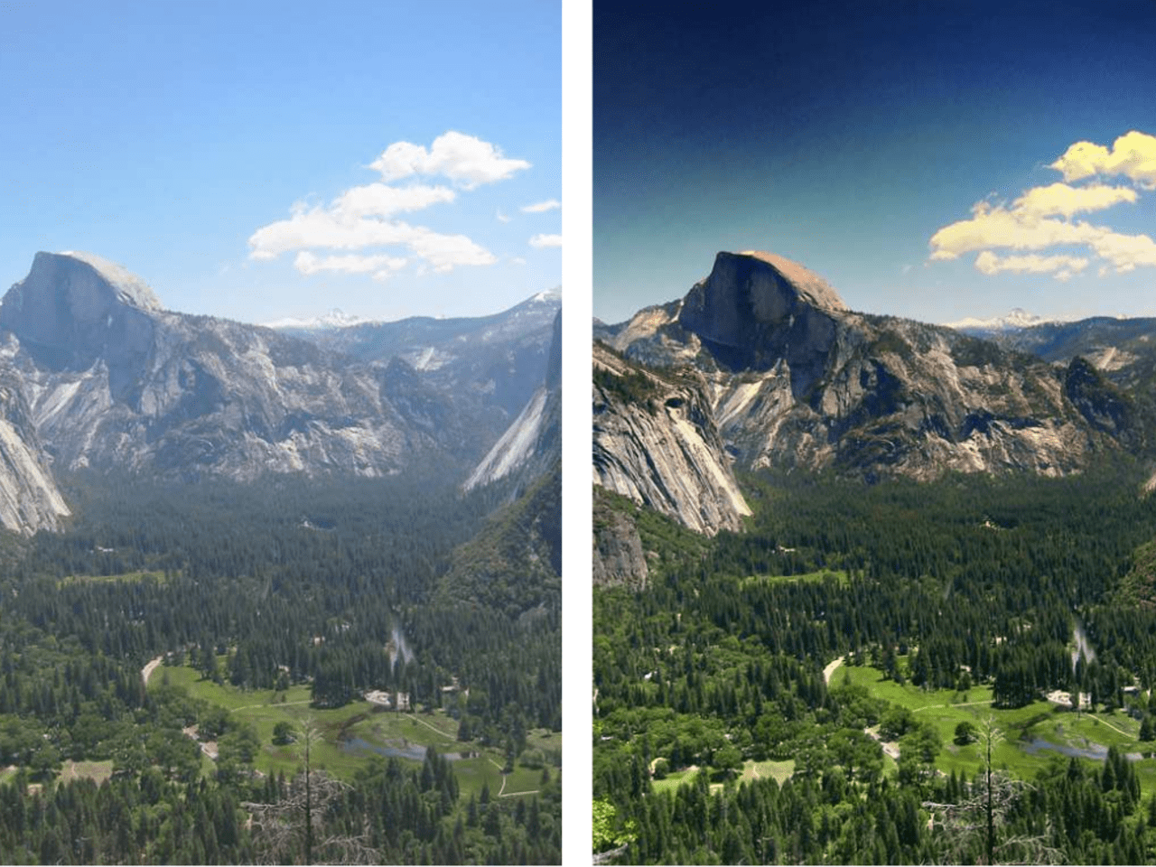
PROBLEM STATEMENT
The problem addressed in this project is the development of an efficient method for dehazing foggy images to improve visibility and enhance image quality. The main goal of this project is to get the better quality of outdoor scene images in adverse weather due to fog and haze.

Slide 9
PROPOSED SYSTEM
Our proposed system comprises preprocessing for image enhancement, Dark Channel Prior for haze removal via transmission map estimation, and post-processing to refine dehazed images, ensuring optimal clarity and visual accuracy.

Slide 10
REQUIREMENTS SPECIFICATION
Functional Requirement :
Haze Model
Transmission Estimation
Scene Reconstruction

Slide 11
REQUIREMENTS SPECIFICATION
Non Functional Requirement :
Hardware Requirements:
Processor : i5 and above
RAM : 8GB and above
Hard Disk : 500GB and above
Software Requirements:
Operating System: Windows 10 & onwards
Language: Python

Slide 12
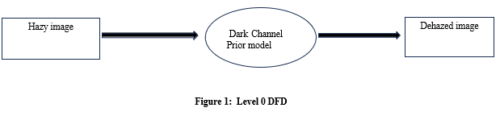
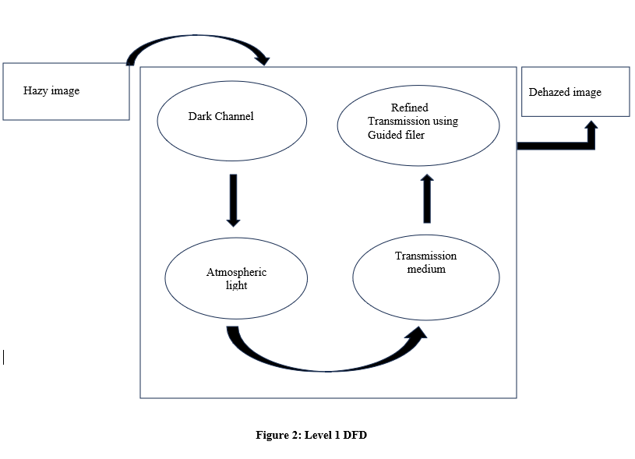
SYSTEM DESIGN
Data Flow Diagram

Slide 13
IMPLEMENTATION
Dark Channel Prior Method
Dark channel prior leverages the statistical pattern that clear outdoor images commonly feature pixels with extremely low intensity values in at least one color channel.

Slide 14
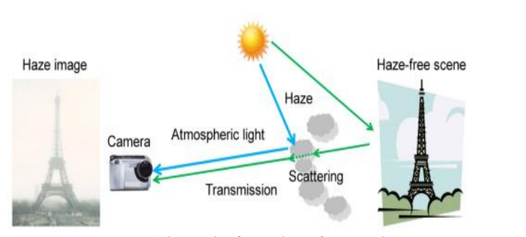
Formation of Haze:
Haze = Airlight + Attenuation
I(x) = J(x)t(x) + A(1 - t(x))
Where,
I(x) – Input Hazy Image
J(x) – Haze free image
t(x) – Transmission value
A – Atmospheric light
J(x)t(x) - Attenuation model
A(1 - t(x)) – Degradation model

Slide 15
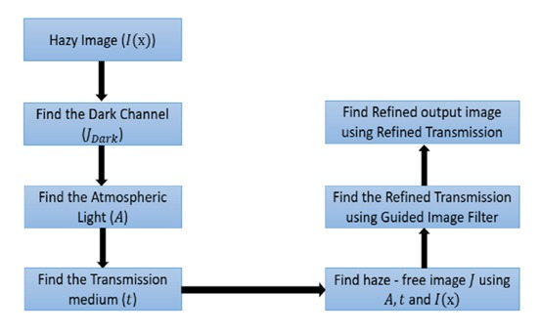
BLOCK DIAGRAM OF SYSTEM DESIGN

Slide 16
STEPS:
Dark Channel Identification:
The dark channel of an image is essentially the minimum intensity value across all color channels for each pixel
Atmospheric Light Estimation:
The atmospheric light A represents the maximum intensity values in the dark channel and is an estimation of the light scattered by the atmosphere
Transmission Map Calculation:
The transmission map t(x) represents the fraction of light that is not scattered or absorbed by the atmosphere.
Transmission Map Refinement:
Quality of the dehazed image depends upon how much accurate the transmission map, so refinement of t(x) is most important. There a are some filters which have been used for refinement.
Guided filter - Designed to take a guidance image (which can be the same or different from the input image) and use it to filter another image.

Slide 17
Tools Used
Python: Python's concise syntax and vast library ecosystem, make it ideal for implementing algorithms efficiently and flexibly.
OpenCV : Utilized for image loading, display, resizing, and saving.
Tkinter : Employed for creating the graphical user interface (GUI) of the haze removal application, including buttons and file dialogs.
NumPy: Utilized for numerical computations, array manipulation, and calculating the Peak Signal-to-Noise Ratio (PSNR) in the haze removal process.

Slide 18
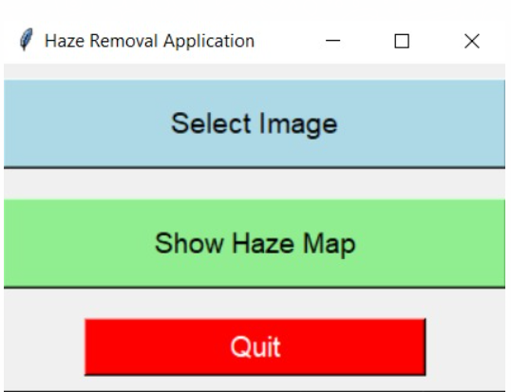
SNAPSHOTS
Home page

Slide 19
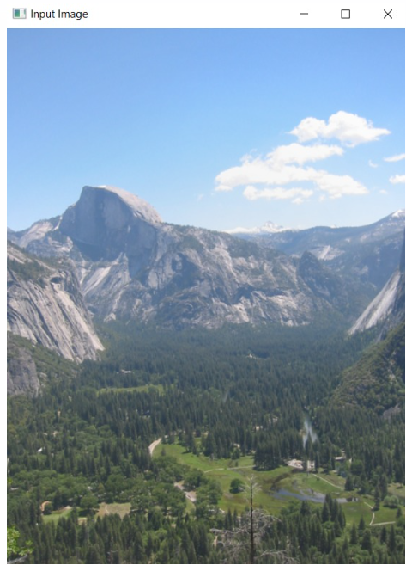
SNAPSHOTS
Input Hazy Image

Slide 20
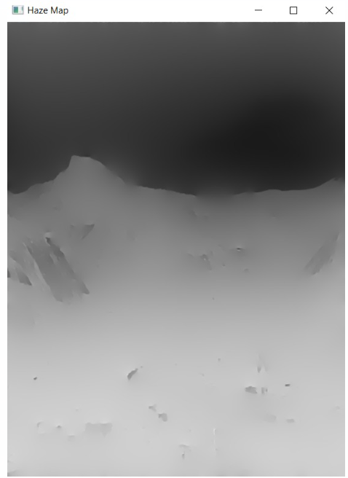
SNAPSHOTS
Haze Map

Slide 21
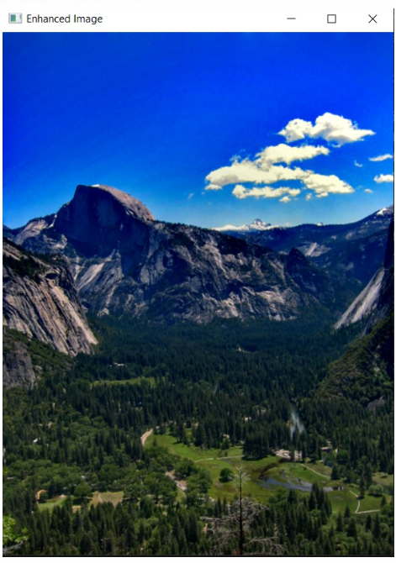
SNAPSHOTS
Output Dehazed Image

Slide 22
CONCLUSION
The image of quality may reduce due the noise present in the atmosphere, which may suppress the details of the images.
The proposed methodology could be used to remove the noise, improve the quality and enhance the details of an image.

Slide 23
THANK YOU

